Slide 1
Unit -4
Agenda
S1 Framing, Flow Control Mechanisms Stop Wait Protocol
S2 Go-back N ARQ, Selective Reject ARQ
S3 CRC, Checksum

Slide 2
Framing
A frame is a digital data transmission unit in computer networking and telecommunication.
Packets contain IP address and routers which work at network layer of OSI model understand packets
Frame is the serial collection of bits, and it encapsulates packets whereas packets are the fragmented form of data and it encapsulates segment
The data link layer needs to pack bits into frames, so that each frame is distinguishable from another
Example
Our postal system practices a type of framing. The simple act of inserting a letter into an envelope separates one piece of information from another; the envelope serves as the delimiter.

Slide 3
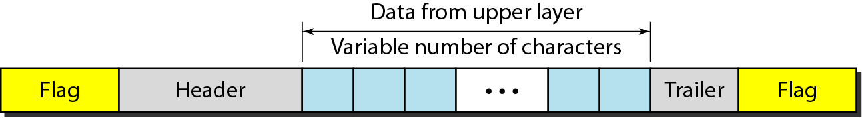
Types of frames
Fixed-Size Framing Variable-Size Framing
A frame in a character-oriented protocol

Slide 4
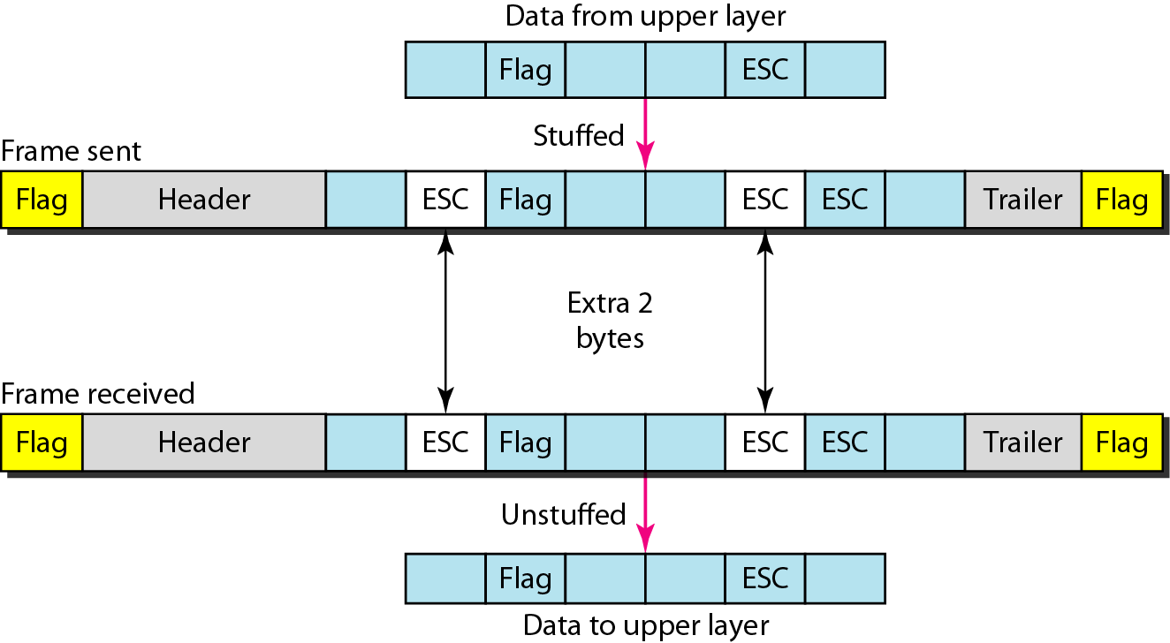
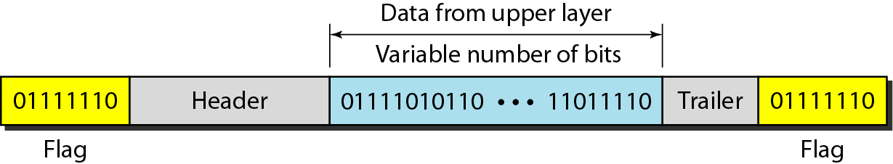
Byte stuffing and unstuffing
Byte stuffing is the process of adding 1 extra byte whenever there is a flag or escape character in the text
A frame in a bit-oriented protocol

Slide 5
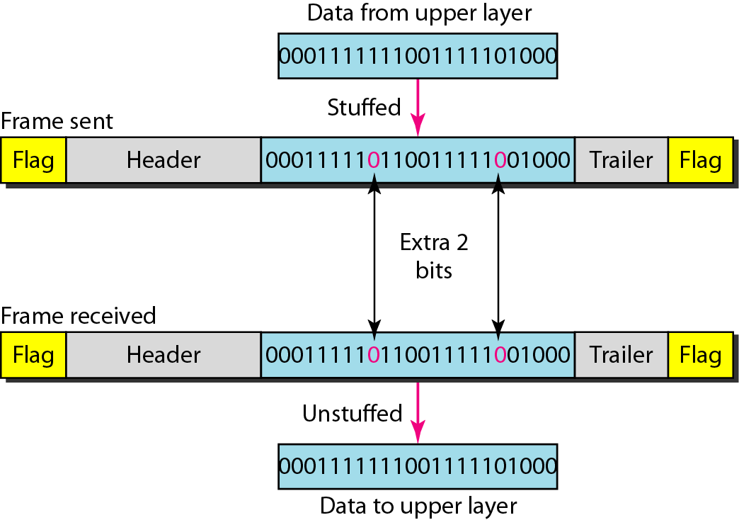
Bit stuffing is the process of adding one extra 0 whenever five consecutive 1s follow a 0 in
the data, so that the receiver does not mistake
the pattern 0111110 for a flag.
Bit stuffing and unstuffing

Slide 6
FLOW AND ERROR CONTROL
The most important responsibilities of the data link layer are flow control and error control. Collectively, these functions are known as data link control
Flow Control: Flow control is the management of data flow between computers or devices or between nodes in a network so that the data can be handled at an efficient pace.
waiting for acknowledgment
Error Control: Error Control in the data link layer is a process of detecting and retransmitting the data which has been lost or corrupted during the transmission of data.
automatic repeat request, which is the retransmission of data

Slide 7
NOISELESS CHANNELS
Let us first assume we have an ideal channel in which no frames are lost, duplicated, or corrupted. We introduce two protocols for this type of channel. Stop-and-Wait Protocol

Slide 8
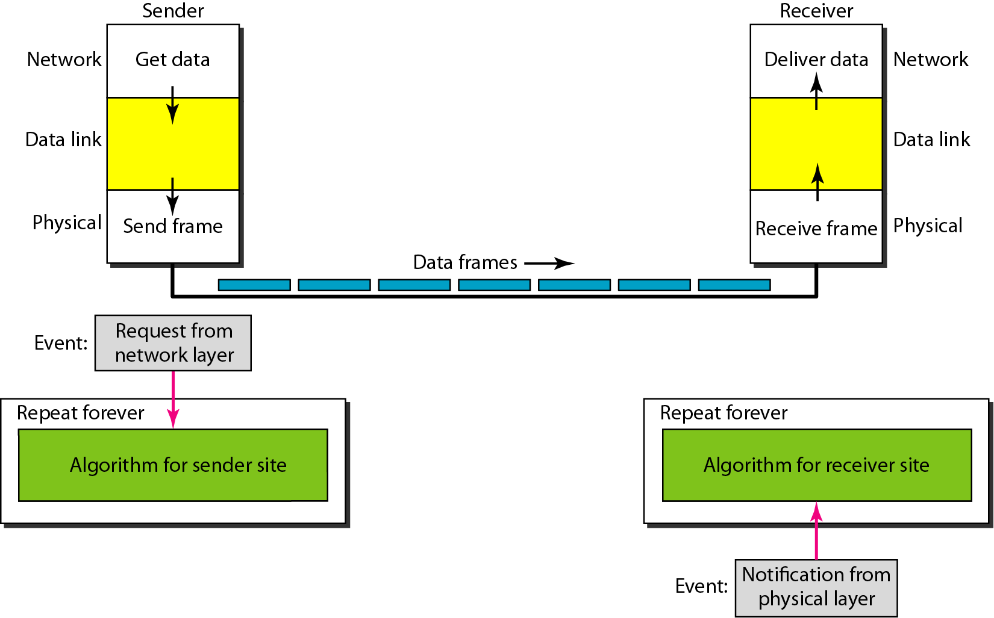
The design of the simplest protocol with no flow or error control

Slide 9
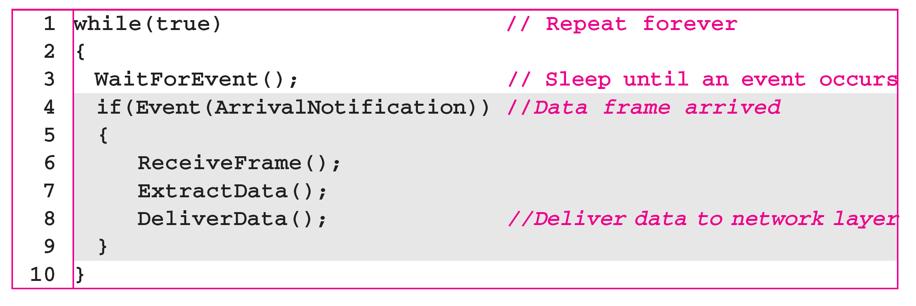
Sender- Receiver-site algorithm for the simplest protocol

Slide 10
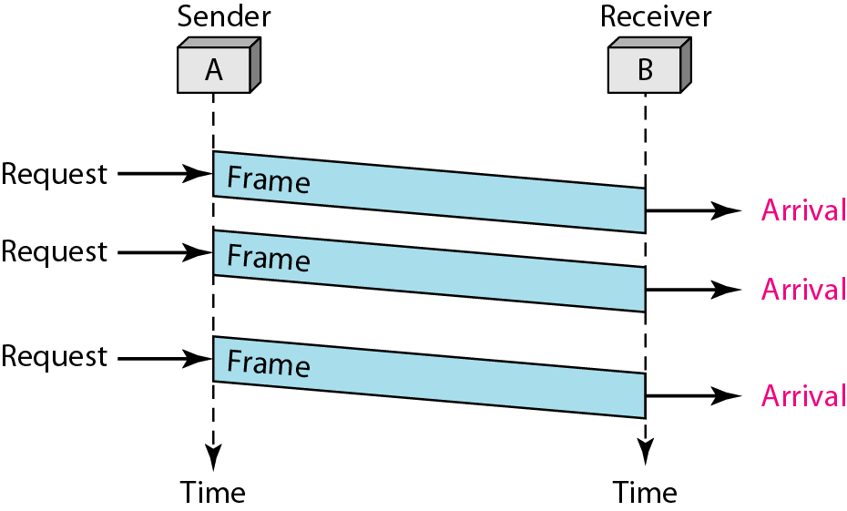
EXAMPLE
shows an example of communication using this protocol. It is very simple. The sender sends a sequence of frames without even thinking about the receiver. To send three frames, three events occur at the sender site and three events at the receiver site. Note that the data frames are shown by tilted boxes; the height of the box defines the transmission time difference between
the first bit and the last bit in the frame

Slide 11
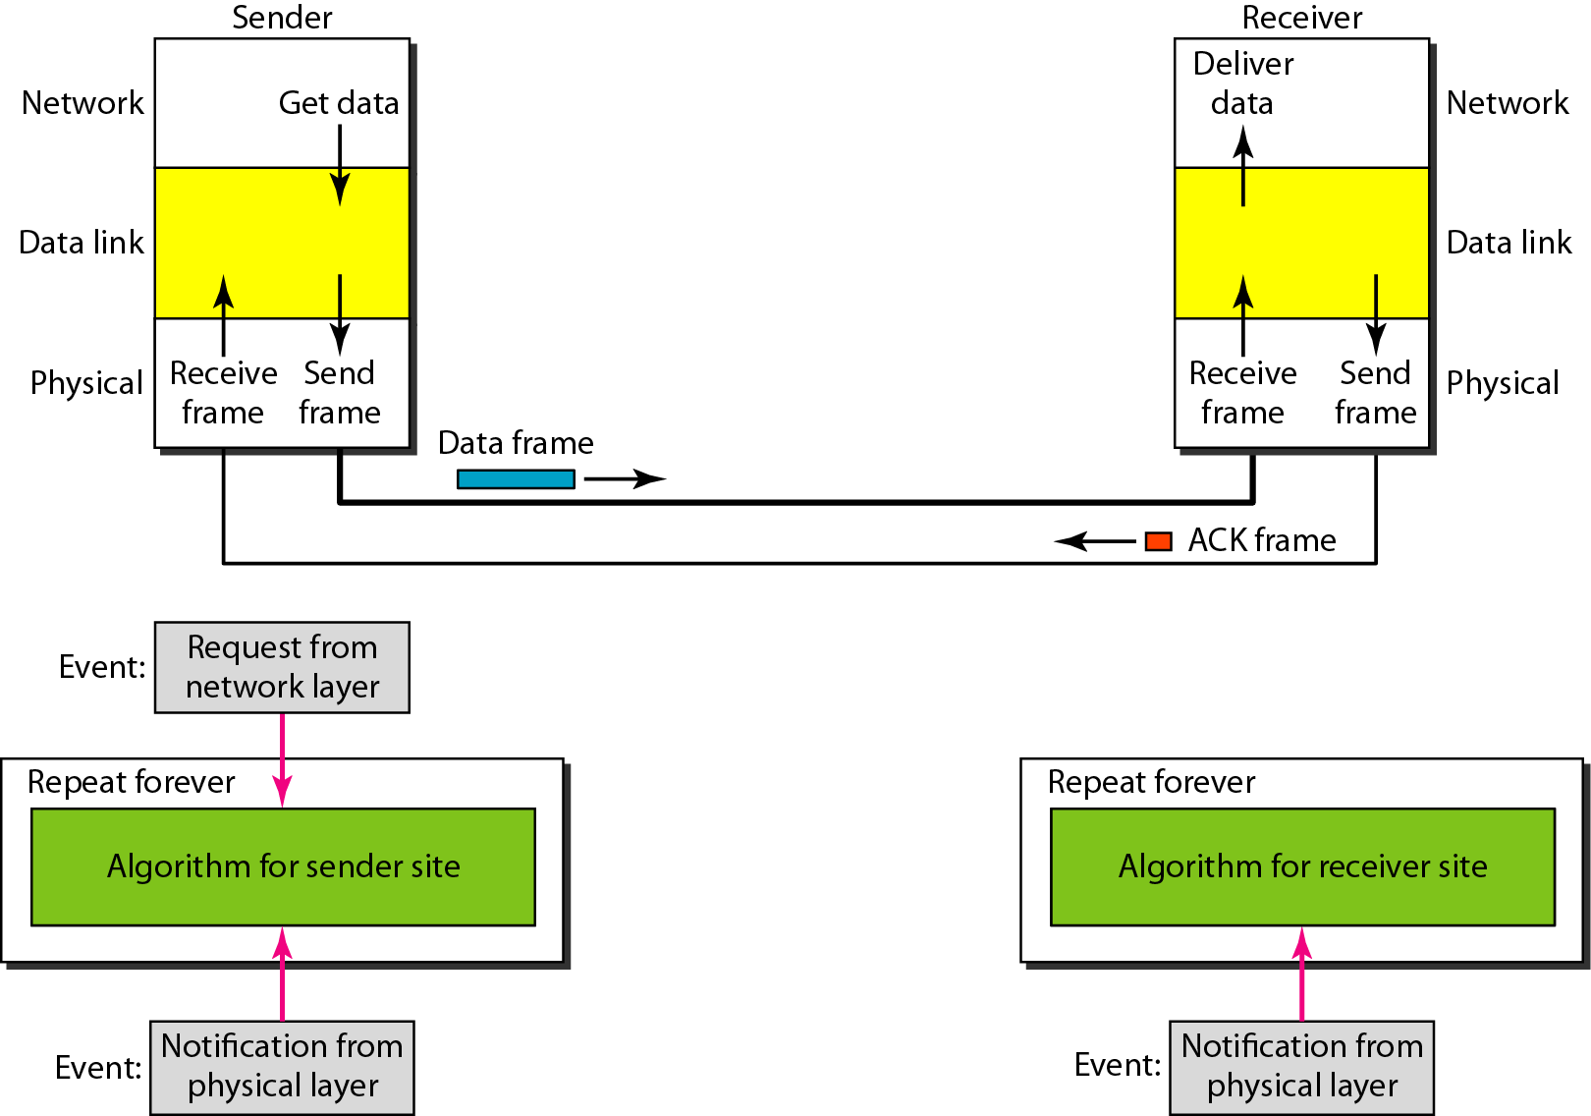
Design of Stop-and-Wait Protocol

Slide 12
Algorithm Sender-site algorithm for Stop-and-Wait Protocol

Slide 13
Algorithm Receiver-site algorithm for Stop-and-Wait Protocol

Slide 14
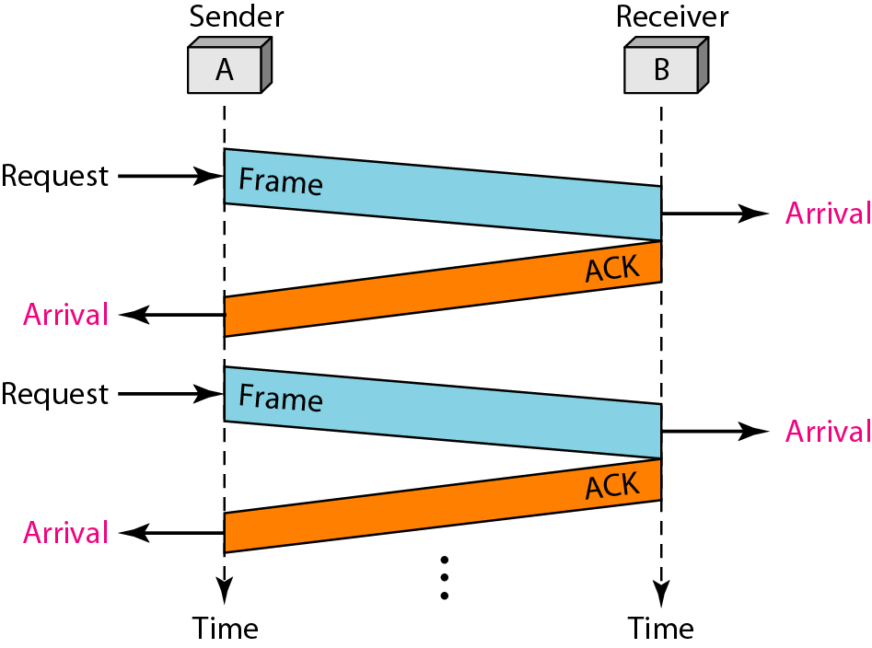
EXAMPLE
Fig.shows an example of communication using this protocol. It is still very simple. The sender sends one frame and waits for feedback from the receiver. When the ACK arrives, the sender sends the next frame. Note that sending two frames in the protocol involves the sender in four events and the receiver in two events

Slide 15
NOISY CHANNELS
Stop-and-Wait Automatic Repeat Request
Go-Back-N Automatic Repeat Request
Selective Repeat Automatic Repeat Request
In Stop-and-Wait ARQ, we use sequence numbers to number the frames.
The sequence numbers are based on modulo-2 arithmetic.
Error correction in Stop-and-Wait ARQ is done by keeping a copy of the sent frame and retransmitting of the frame when the timer expires
In Stop-and-Wait ARQ, the acknowledgment number always announces in modulo-2 arithmetic the sequence number of the next frame expected

Slide 16
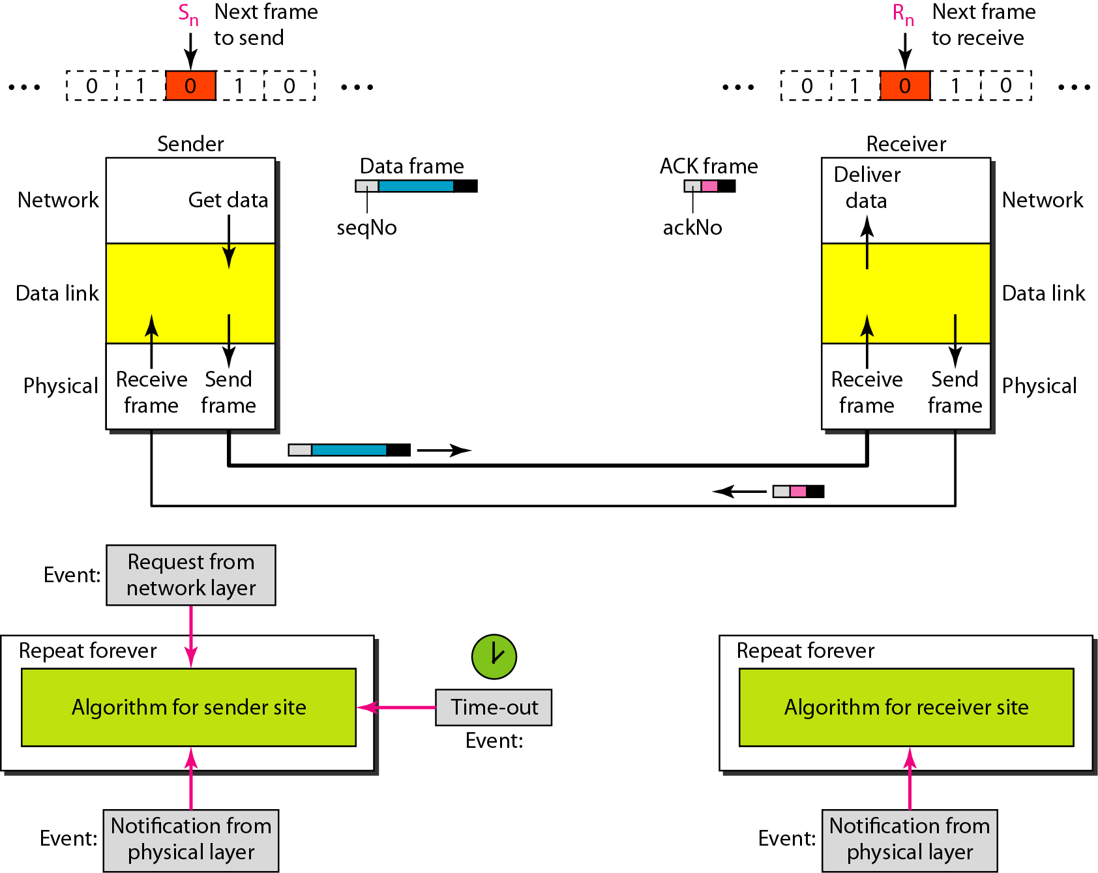
Design of the Stop-and-Wait ARQ Protocol

Slide 17
EXAMPLE
Following fig. shows an example of Stop-and-Wait ARQ. Frame 0 is sent and acknowledged. Frame 1 is lost and resent after the time-out. The resent frame 1 is acknowledged and the timer stops. Frame 0 is sent and acknowledged, but the acknowledgment is lost. The sender has no idea if the frame or the acknowledgment is lost, so after the time-out, it resends frame 0, which is acknowledged

Slide 18
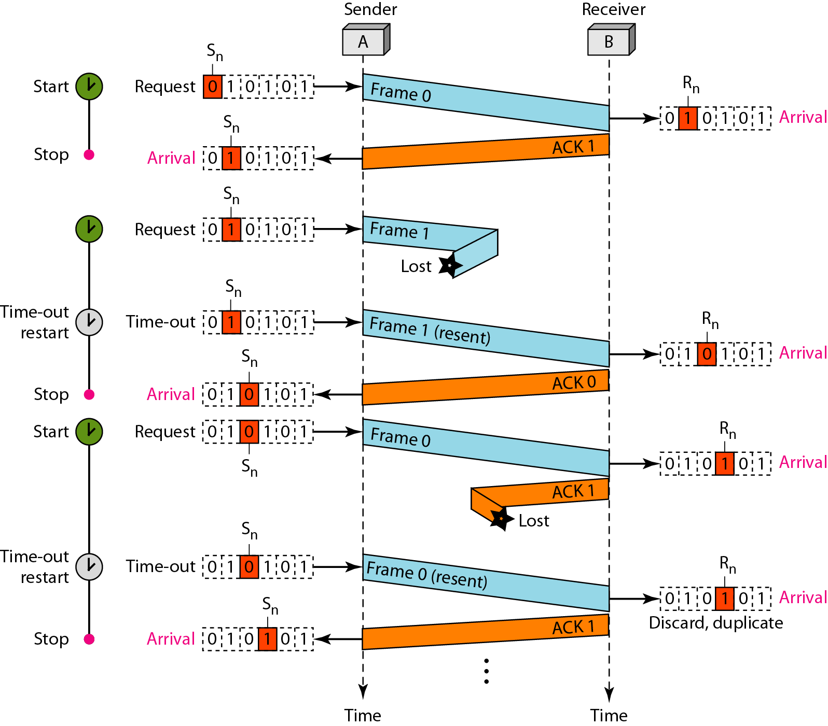

Slide 19
EXAMPLE 2
Assume that, in a Stop-and-Wait ARQ system, the bandwidth of the line is 1 Mbps, and 1 bit takes 20 ms to make a round trip. What is the bandwidth-delay product? If the system data frames are 1000 bits in length, what is the utilization percentage of the link?
Solution
The bandwidth-delay product is

Slide 20
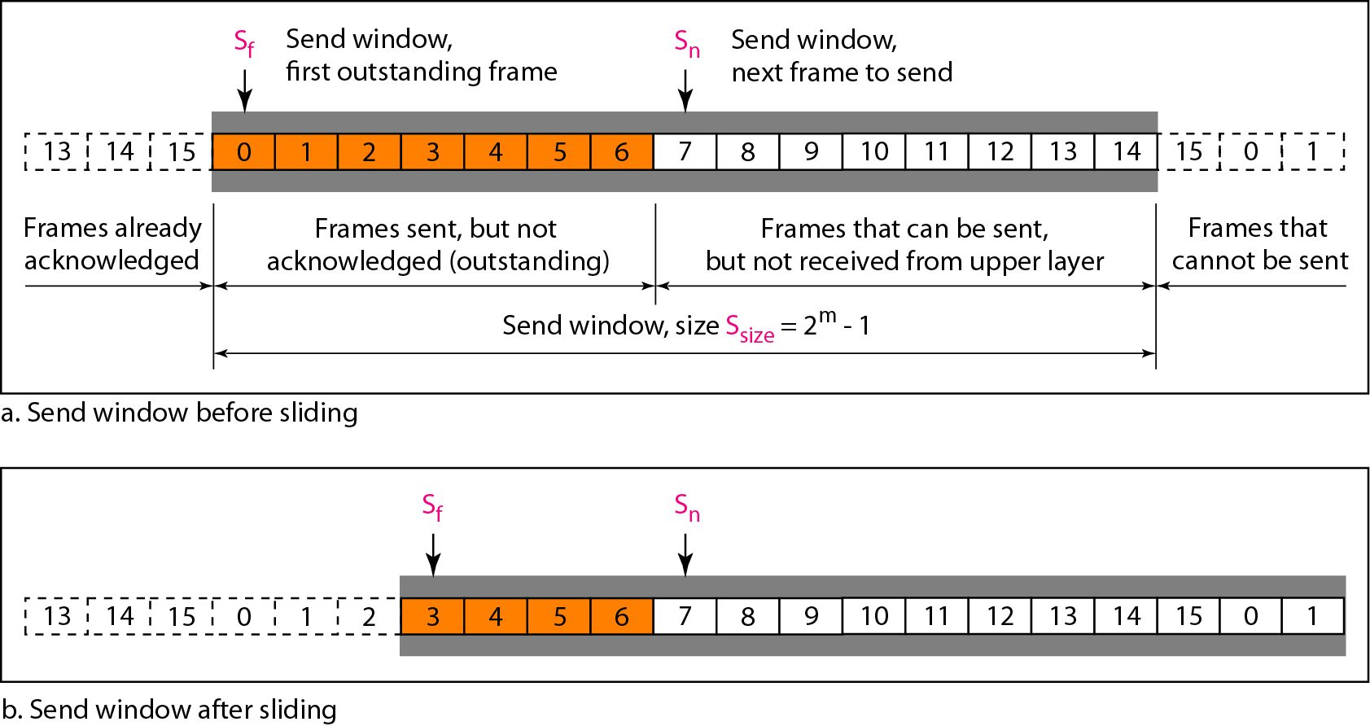
In the Go-Back-N Protocol, the sequence numbers are modulo 2^{m},
where m is the size of the sequence number field in bits
Send window for Go-Back-N ARQ

Slide 21
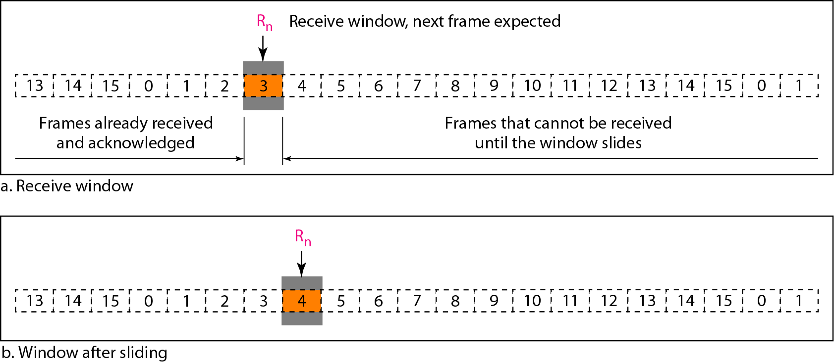
Receive window for Go-Back-N ARQ

Slide 22
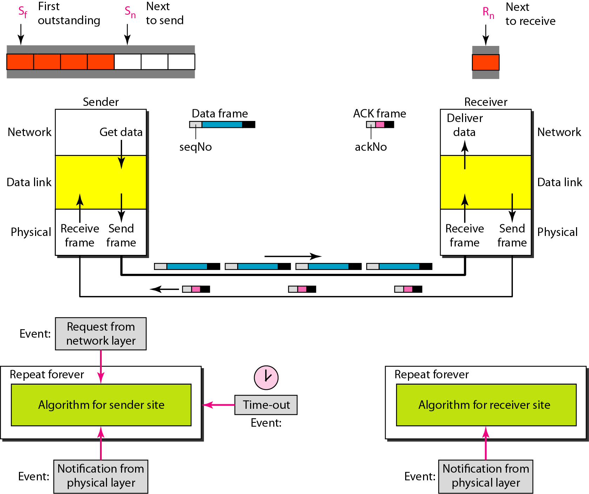
Design of Go-Back-N ARQ

Slide 23
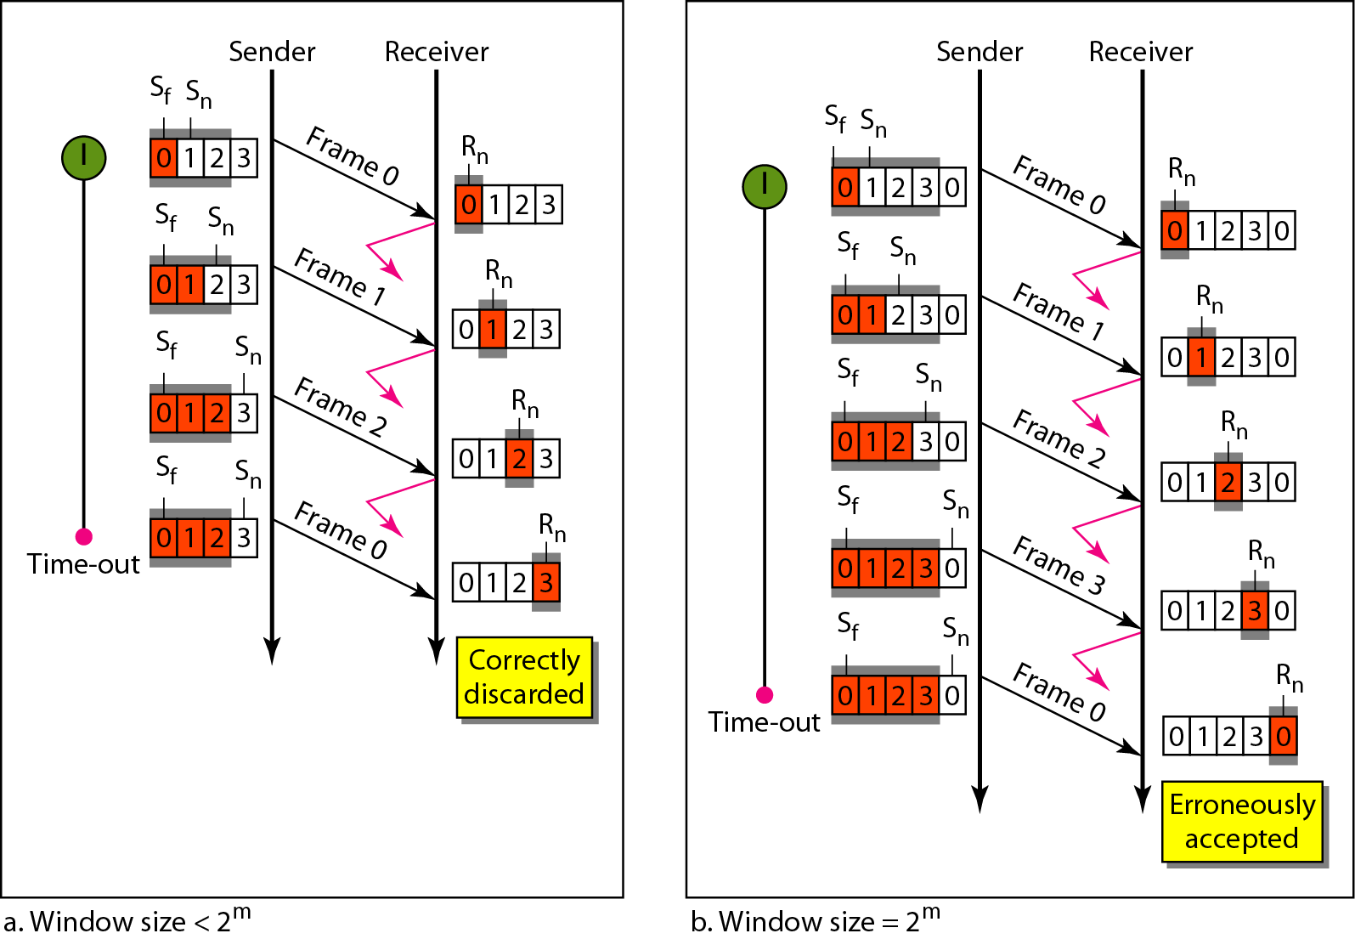
Window size for Go-Back-N ARQ
In Go-Back-N ARQ, the size of the send window must be less than 2^{m};the size of the receiver window is always 1

Slide 24
EXAMPLE
Previous Fig. shows an example of Go-Back-N. This is an example of a case where the forward channel is reliable, but the reverse is not. No data frames are lost, but some ACKs are delayed and one is lost. The example also shows how cumulative acknowledgments can help if acknowledgments are delayed or lost. After initialization, there are seven sender events. Request events are triggered by data from the network layer; arrival events are triggered by acknowledgments from the physical layer. There is no time-out event here because all outstanding frames are acknowledged before the timer expires. Note that although ACK 2 is lost, ACK 3 serves as both ACK 2 and ACK 3

Slide 25
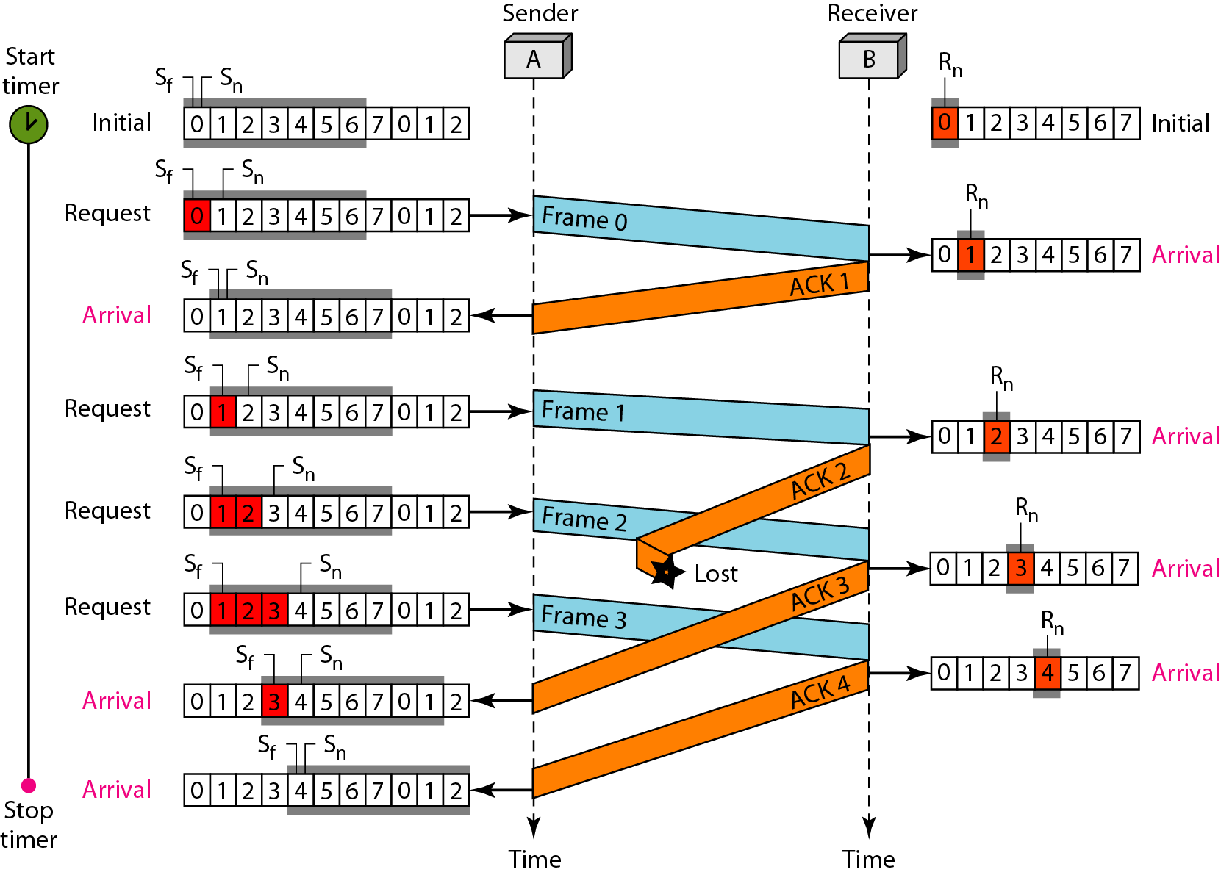
Figure 11.16 Flow diagram for Example 11.6

Slide 26
Previous fig. shows what happens when a frame is lost. Frames 0, 1, 2, and 3 are sent. However, frame 1 is lost. The receiver receives frames 2 and 3, but they are discarded because they are received out of order. The sender receives no acknowledgment about frames 1, 2, or 3. Its timer finally expires. The sender sends all outstanding frames (1, 2, and 3) because it does not know what is wrong. Note that the resending of frames 1, 2, and 3 is the response to one single event. When the sender is responding to this event, it cannot accept the triggering of other events. This means that when ACK 2 arrives, the sender is still busy with sending frame 3
The physical layer must wait until this event is completed and the data link layer goes back to its sleeping state. We have shown a vertical line to indicate the delay. It is the same story with ACK 3; but when ACK 3 arrives, the sender is busy responding to ACK 2. It happens again when ACK 4 arrives. Note that before the second timer expires, all outstanding frames have been sent and the timer is stopped.

Slide 27
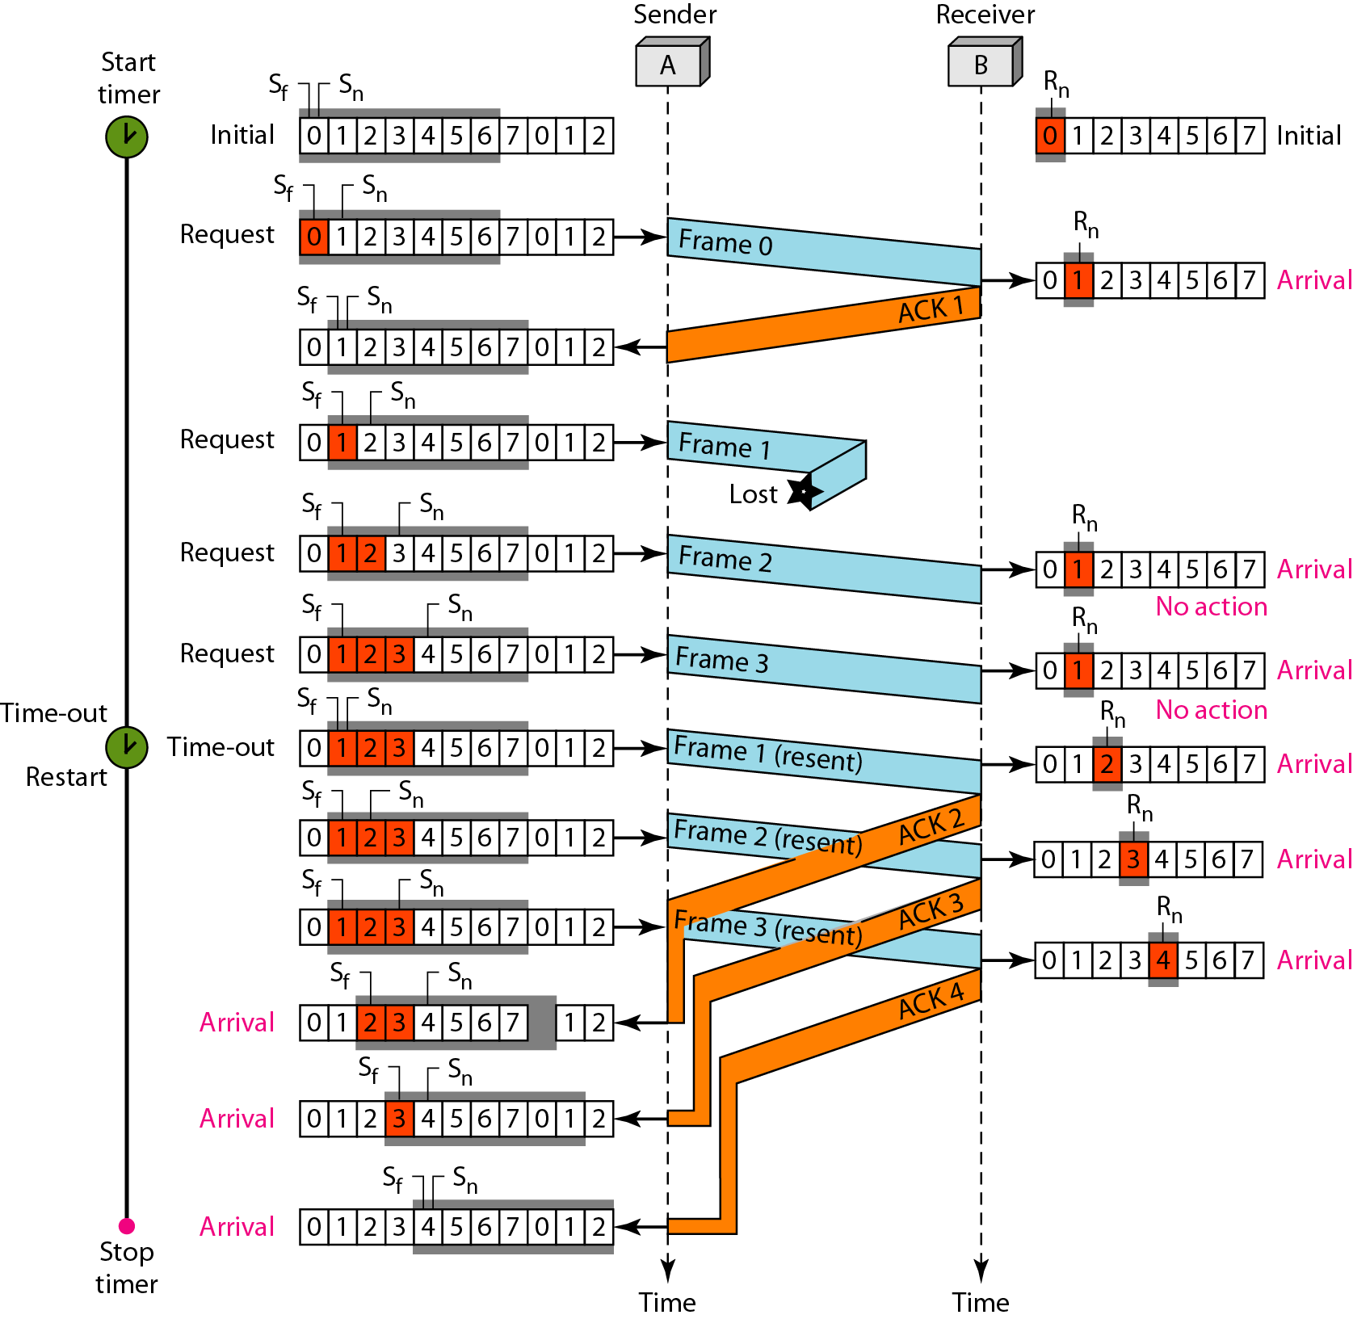
Flow diagram for Example 11.7

Slide 28
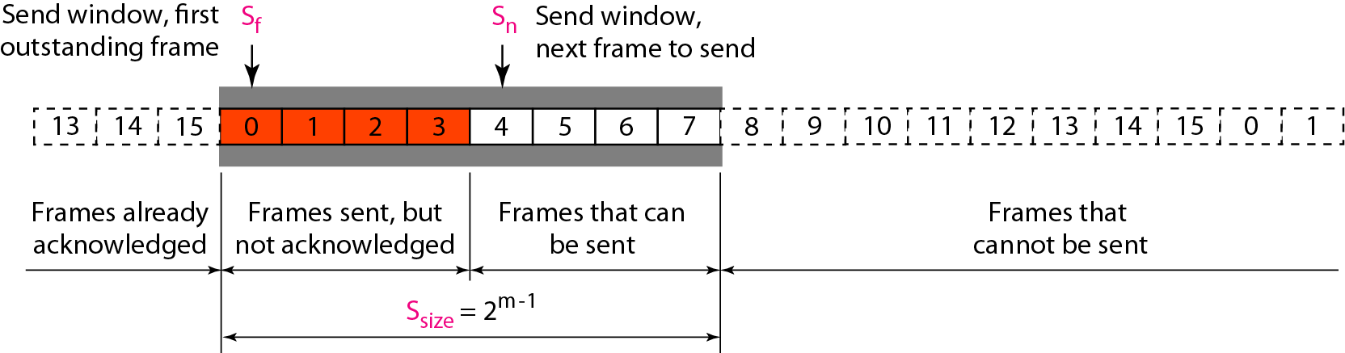
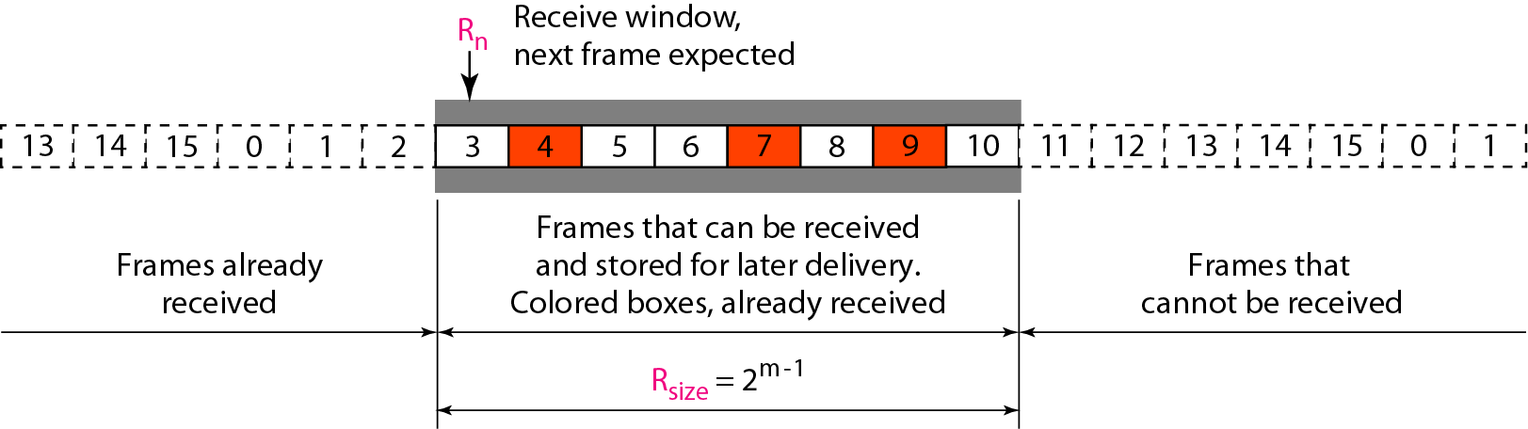
Stop-and-Wait ARQ is a special case of Go-Back-N ARQ in which the size of the send window is 1
Send window for Selective Repeat ARQ
Receive window for Selective Repeat ARQ

Slide 29
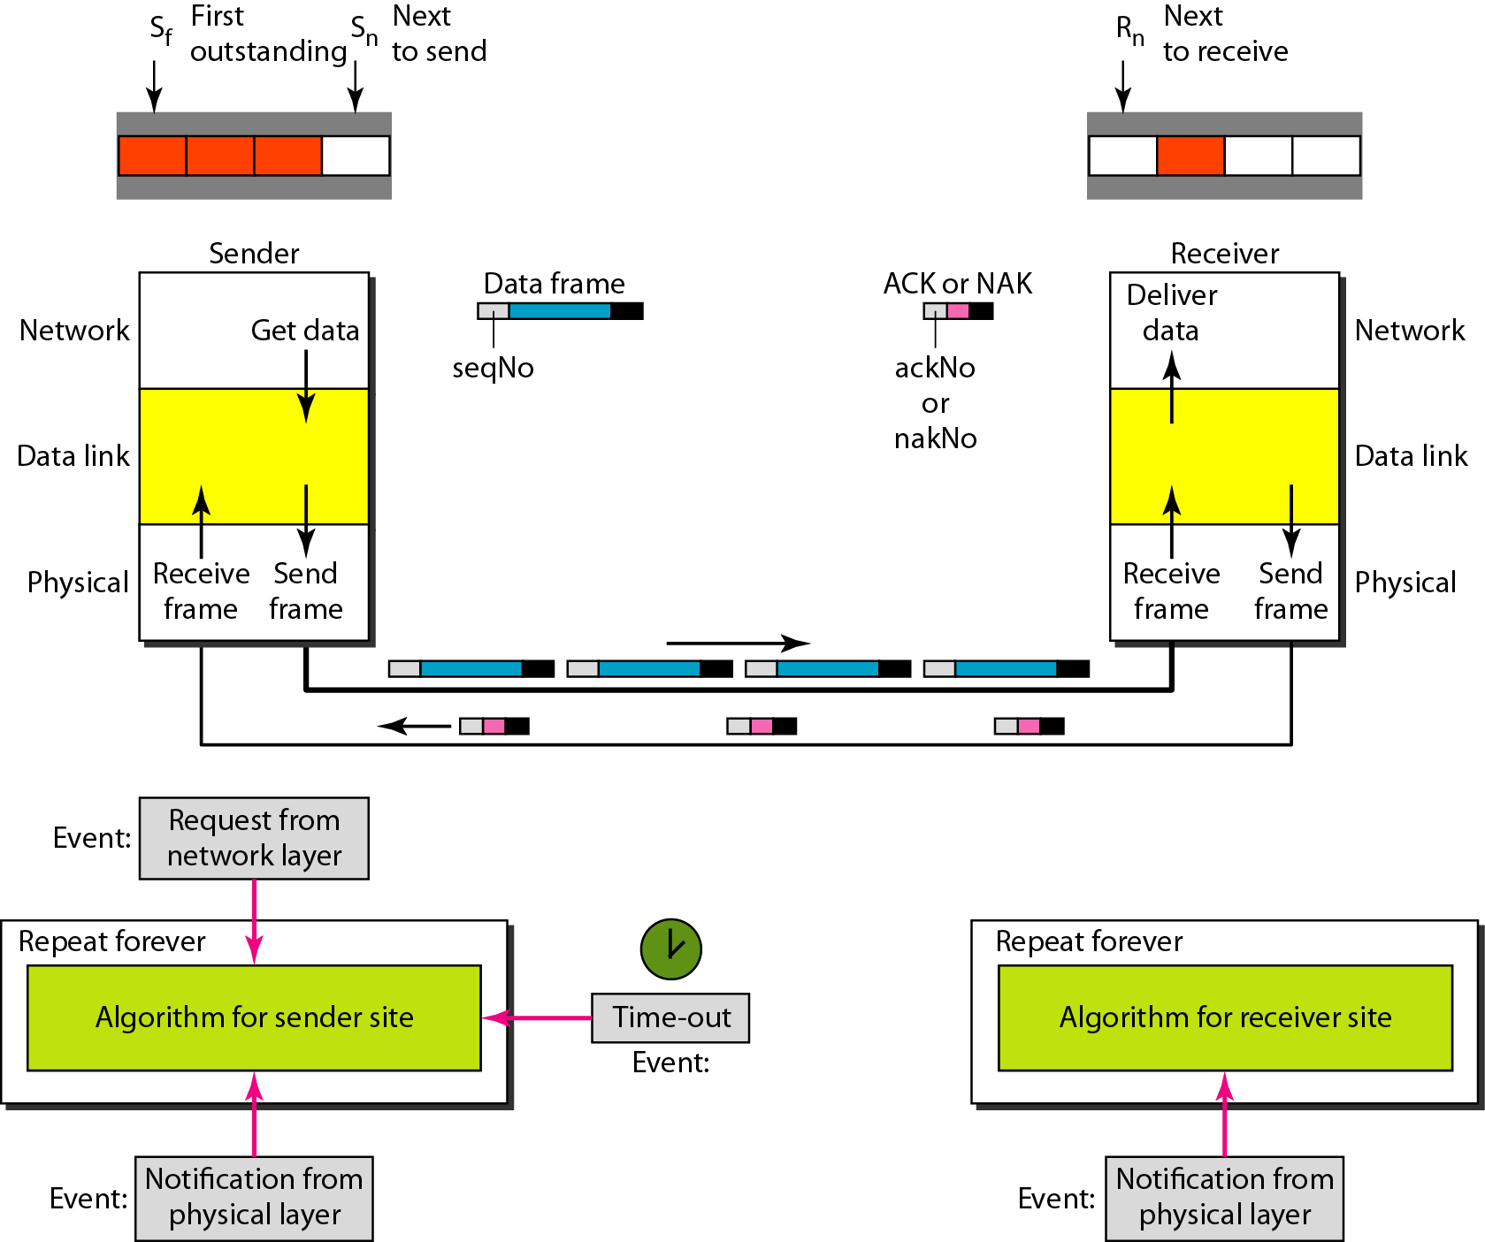
Design of Selective Repeat ARQ

Slide 30
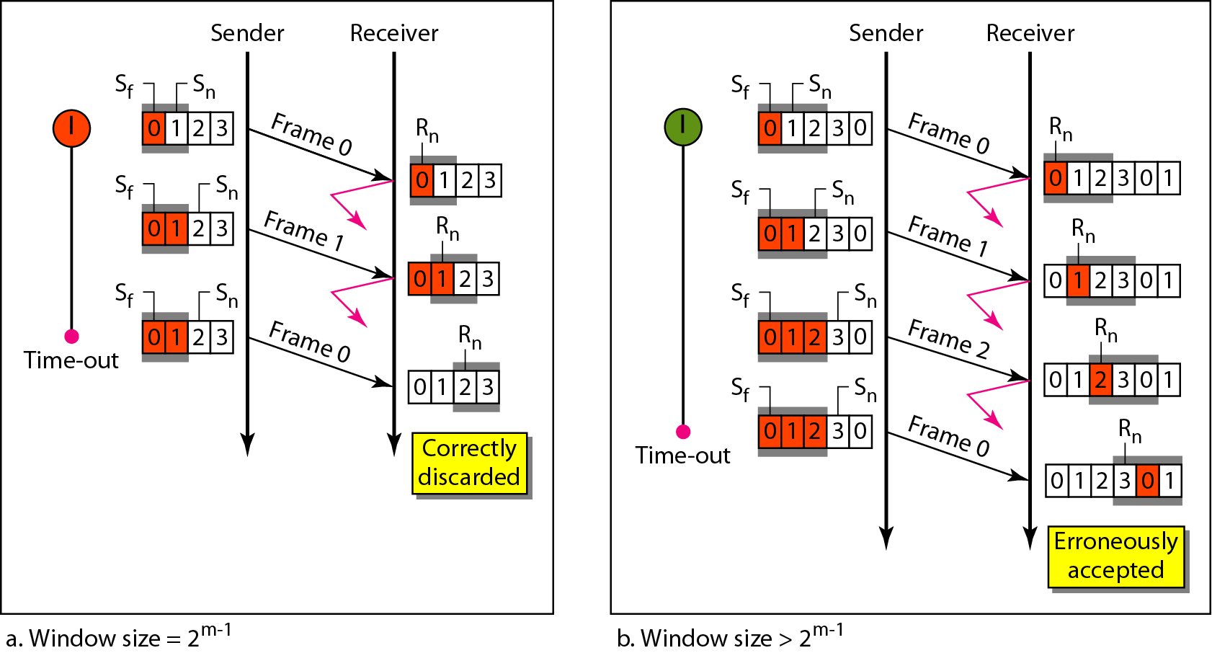
Selective Repeat ARQ, window size

Slide 31
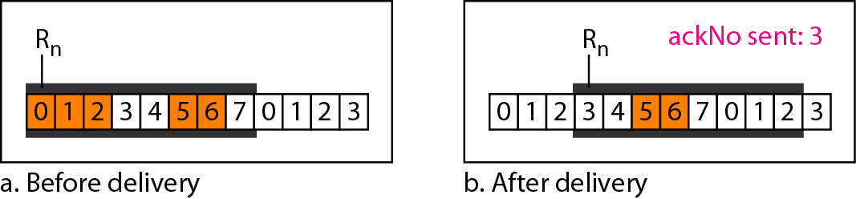
In Selective Repeat ARQ, the size of the sender and receiver window
must be at most one-half of 2^{m}
Delivery of data in Selective Repeat ARQ

Slide 32
Receive window for Selective Repeat ARQ

Slide 33
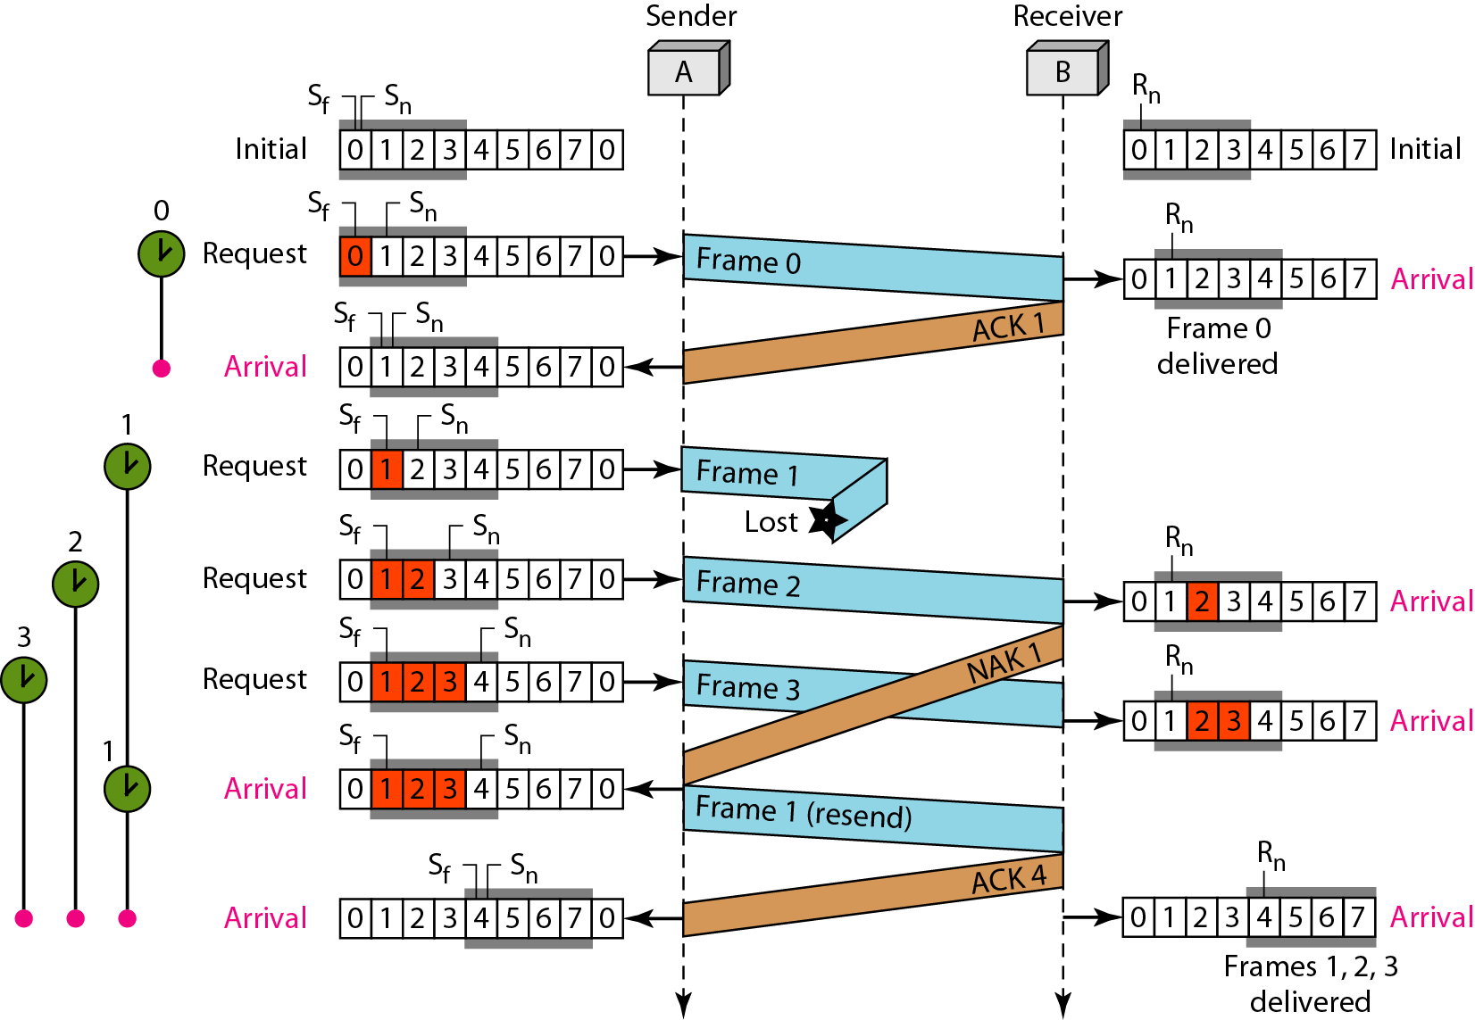

Slide 34
Previous fig. shows the situation. One main difference is the number of timers. Here, each frame sent or resent needs a timer, which means that the timers need to be numbered (0, 1, 2, and 3). The timer for frame 0 starts at the first request, but stops when the ACK for this frame arrives. The timer for frame 1 starts at the second request, restarts when a NAK arrives, and finally stops when the last ACK arrives. The other two timers start when the corresponding frames are sent and stop at the last arrival event
At the receiver site we need to distinguish between the acceptance of a frame and its delivery to the network layer. At the second arrival, frame 2 arrives and is stored and marked, but it cannot be delivered because frame 1 is missing. At the next arrival, frame 3 arrives and is marked and stored, but still none of the frames can be delivered. Only at the last arrival, when finally a copy of frame 1 arrives, can frames 1, 2, and 3 be delivered to the network layer. There are two conditions for the delivery of frames to the network layer: First, a set of consecutive frames must have arrived. Second, the set starts from the beginning of the window.

Slide 35
Another important point is that a NAK is sent after the second arrival, but not after the third, although both situations look the same.
The reason is that the protocol does not want to crowd the network with unnecessary NAKs and unnecessary resent frames. The second NAK would still be NAK1 to inform the sender to resend frame 1 again; this has already been done.
The first NAK sent is remembered (using the nakSent variable) and is not sent again until the frame slides.
A NAK is sent once for each window position and defines the first slot in the window.
The next point is about the ACKs. Notice that only two ACKs are sent here. The first one acknowledges only the first frame; the second one acknowledges three frames.
In Selective Repeat, ACKs are sent when data are delivered to the network layer. If the data belonging to n frames are delivered in one shot, only one ACK is sent for all of them

Slide 36
Error Detection & Correction
When an electromagnetic signal flows from one point to another it is subject to interference from heat, magnetism and other forms of electricity
This interference can change the shape of signal
When these signals is carrying binary data, such changes can alter meaning of data resulting in error.
Error when we say can be classified into two types- Single bit and Burst
Single bit error: Error where only one bit of given data unit such as byte, character or packet is changed from 0 to 1.
Burst Error : Error where two or more bits in a given data unit have changed from 1 to 0 or 0 to 1.

Slide 37
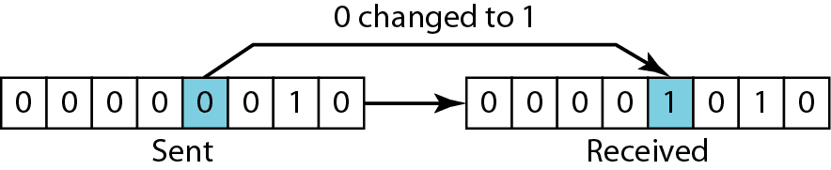

Slide 38
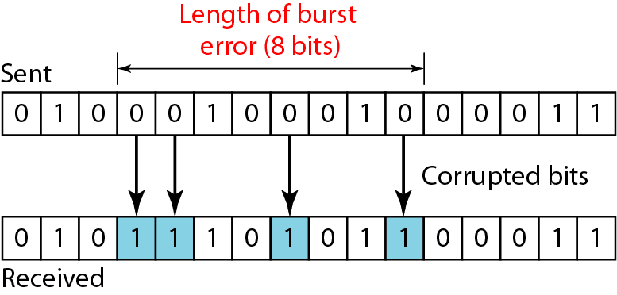

Slide 39
Cyclic Redundancy Check (CRC)
The most powerful redundancy checking technique is CRC
This method uses binary division unlike LRC and VRC which uses binary addition.
In CRC instead of adding bits together to achieve a desired parity, Sequence of redundant bits called CRC or CRC remainder is appended to the end of data unit so the resultant data unit becomes exactly divisible by second predetermined number which is the divisor.
At receiver, incoming data unit is divided by the same divisor
If there is no remainder, data unit is assumed to be intact and accepted.
If there is a remainder it means data is been damaged in transit and must be rejected.

Slide 40
CRC

Slide 41
CRC Algorithm
First a string of 0’s appended to data unit. The number n is less than the number of bits in the divisor which is n+1
Secondly new elongated data is divided by the divisor using a process of modulo 2 binary division
Remainder resulting from division is CRC
CRC of n bits derived which is the remainder is appended to the data unit by replacing the appended 0’s
This data unit arrives at the receiver followed by CRC
Now the receiver divides the data unit by the same divisor to find the remainder
If remainder is 0 it means data is error free and is accepted
If remainder is non zero, data got error and is rejected.

Slide 42
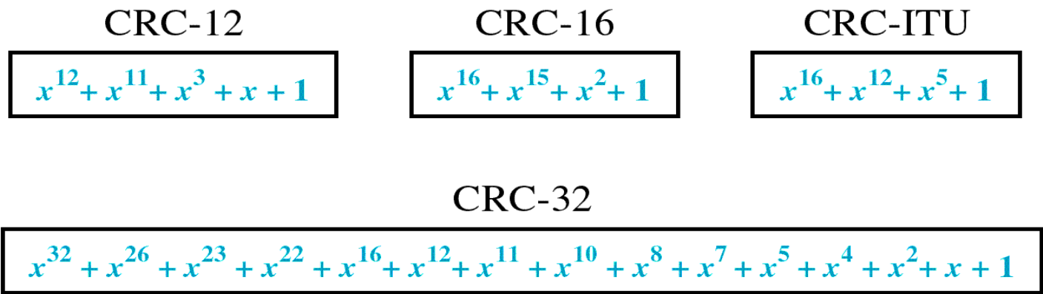
CRC Generator
CRC generator i.e. divisor is often represented as a string of 1s and 0s but as algebraic polynomial
Polynomial is represented as x⁷+ x⁶+ x⁴ +x³ +x +1
Relationship of polynomial to corresponding binary representation is 11011011
Standard CRC polynomials are CRC-12, CRC-16, CRC-ITU-T and CRC-32

Slide 43
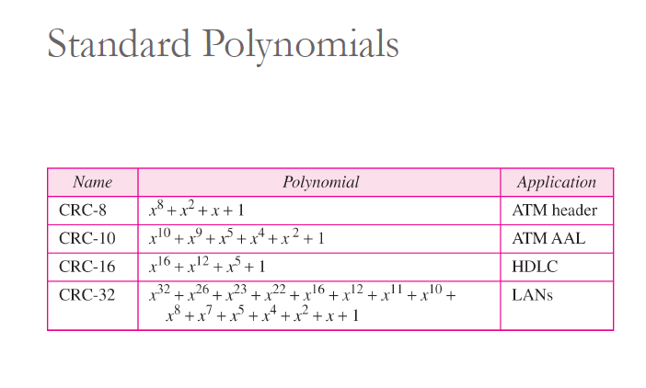

Slide 44
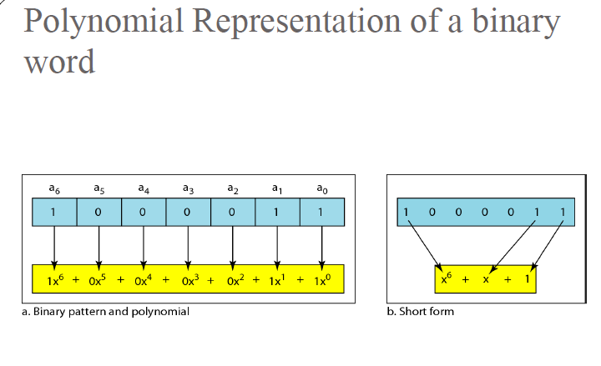

Slide 45
Polynomia

Slide 46
Polynomial and Divisor

Slide 47
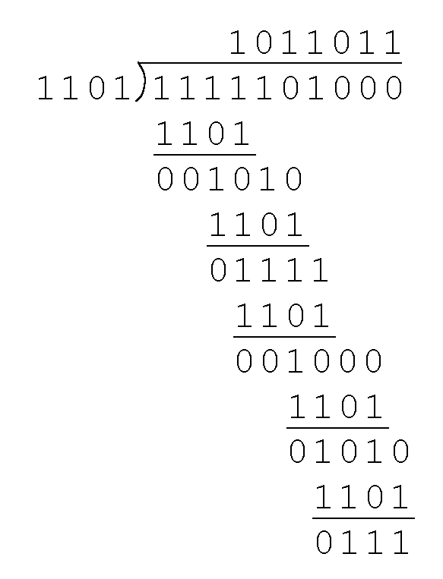
CRC Example
Example: Suppose sender want to transmit the information string: 1111101. The receiver and sender decide to use the (arbitrary) polynomial pattern, 1101 which is the divisor

Slide 48
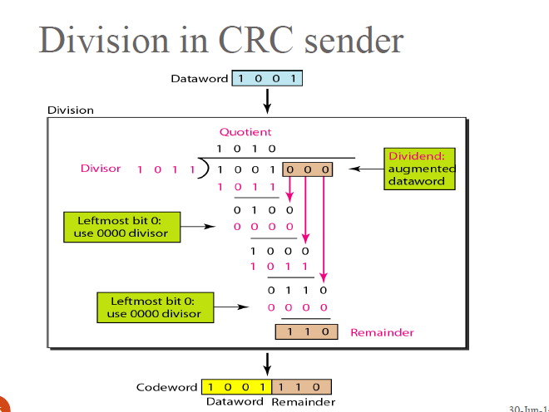
CRC

Slide 49

CHECKSUM
Error detection used by higher layer protocols is Checksum
Checksum also is based on the concept of redundancy
Check sum Generator :
In sender, checksum generator subdivides the data unit into equal segments of n bits usually 16
These segments are added together using one’s complement arithmetic so that total is also n bits long
The total is then complemented and appended to the end of the original data unit as redundancy bits called checksum bits.

Slide 50
Checksum

Slide 51
At the sender
The unit is divided into k sections, each of n bits.
All sections are added together using one’s complement to get the sum.
The sum is complemented and becomes the checksum.
The checksum is sent with the data
At the Receiver
The unit is divided into k sections, each of n bits.
All sections are added together using one’s complement to get the sum.
The sum is complemented.
If the result is zero, the data are accepted: otherwise, they are rejected.

Slide 52
Performance
The checksum detects all errors involving an odd number of bits.
It detects most errors involving an even number of bits.
If one or more bits of a segment are damaged and the corresponding bit or bits of opposite value in a second segment are also damaged, the sums of those columns will not change and the receiver will not detect a problem.
Data Unit and Checksum

